Slide 1


MULTIMEDIA MULTIMEDIA MULTIMEDIA MULTIMEDIA MULTIMEDIA MULTIMEDIA MULTIMEDIA
IT

Slide 2
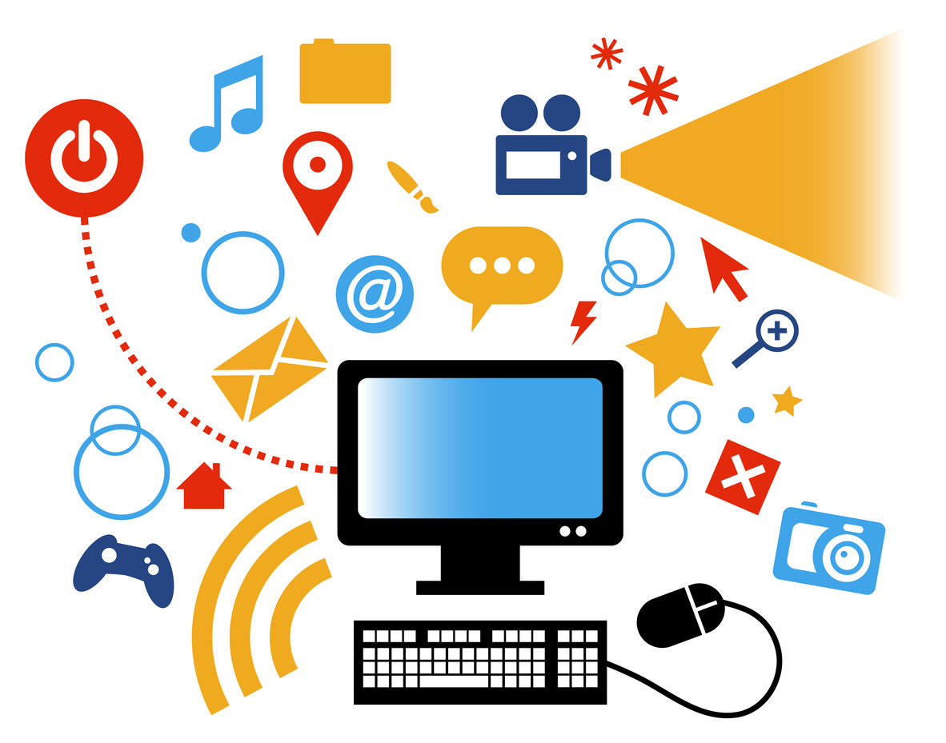
Multimedia refers to the combined use of different forms of media elements such as text, images, audio, video, and interactive content to convey information, entertain, or engage an audience

Slide 3
MULTIMEDIA MULTIMEDIA MULTIMEDIA MULTIMEDIA MULTIMEDIA MULTIMEDIA MULTIMEDIA
IT
WEB

Slide 4
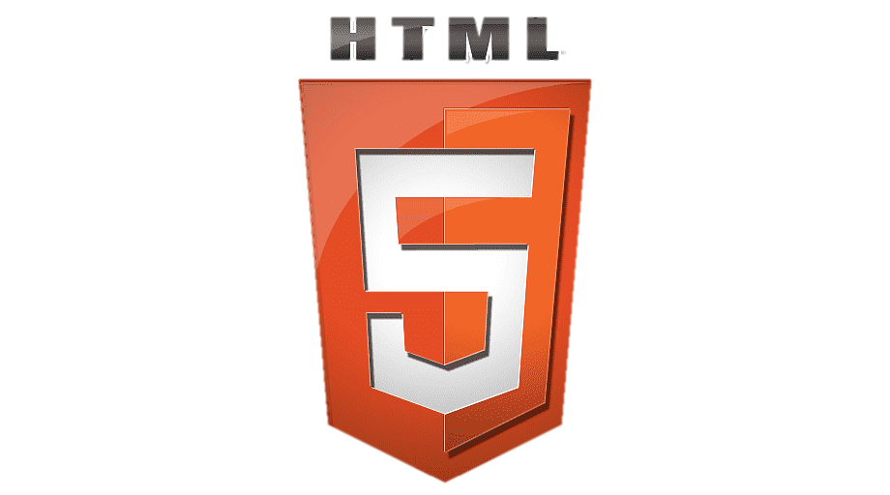
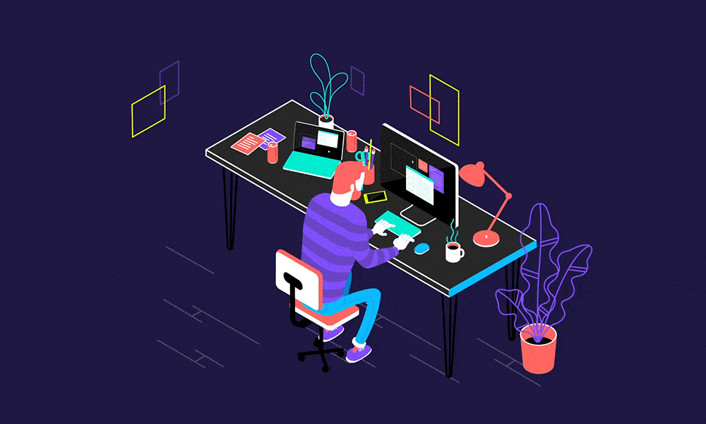
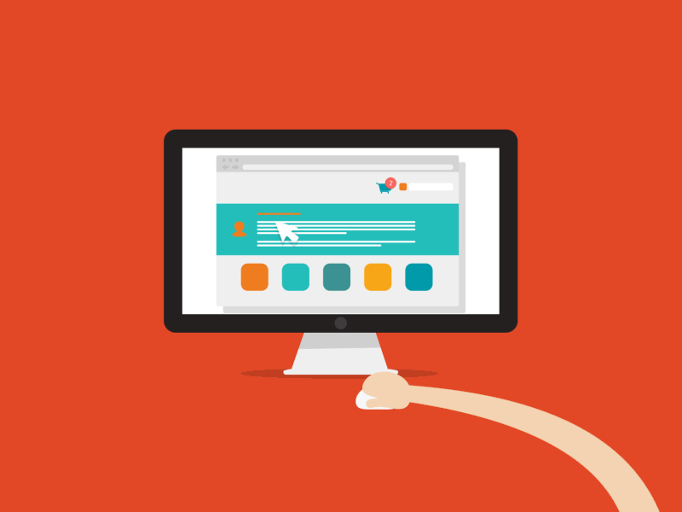
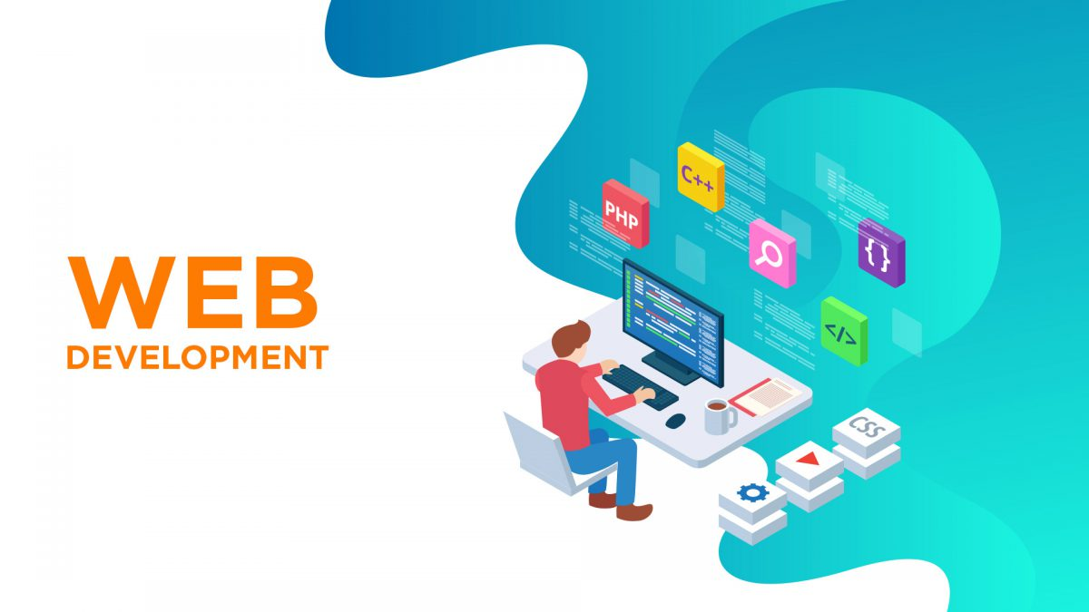

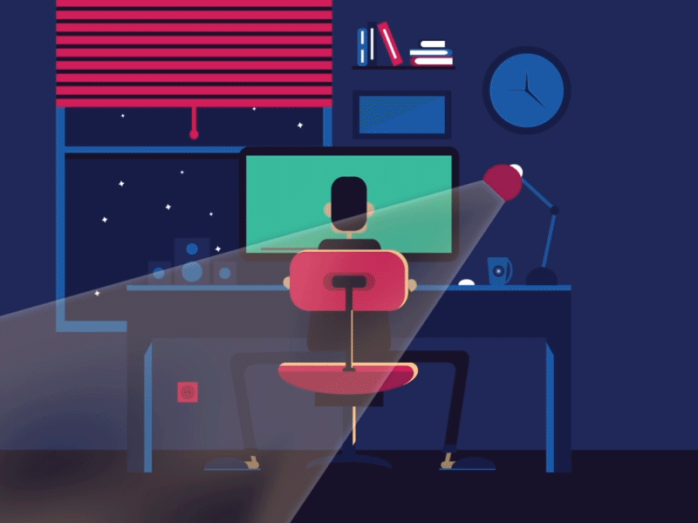

WHAT IT IS?

Slide 5
Web development is the process of creating and maintaining websites and web applications. It involves a variety of tasks, including web design, front-end development, back-end development, and server management. Web developers use various programming languages, frameworks, and tools to build websites that can range from simple static pages to complex, dynamic web applications.

Slide 6
what it is?

Slide 7

HTML, or Hypertext Markup Language, is the standard markup language used to create the structure and content of web pages. HTML is essential for building websites, as it defines the elements and structure of a web page, allowing web browsers to render and display the content appropriately.

Slide 8

what it is?

Slide 9
JavaScript (often abbreviated as JS) is a versatile and widely used programming language primarily employed for web development but also applied in various other contexts.

Slide 10
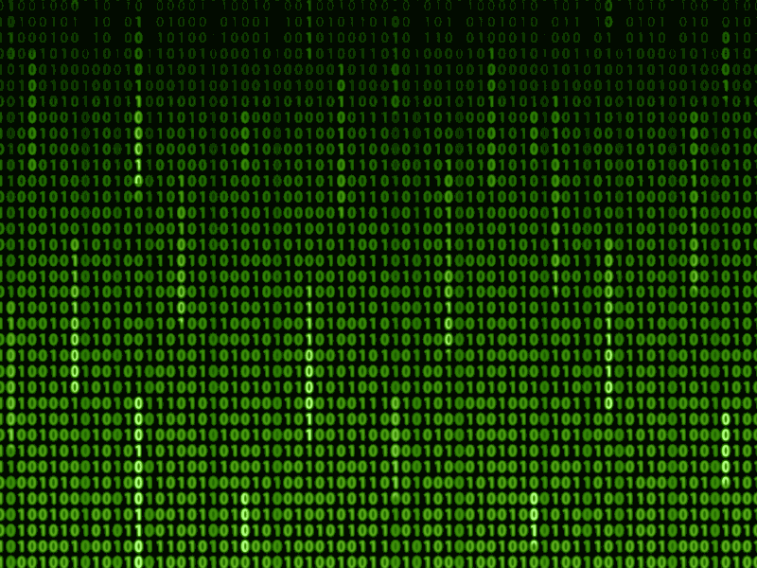
what it is?

Slide 11
CSS, which stands for Cascading Style Sheets, is a fundamental technology used in web development. It complements HTML by providing a means to control the presentation and styling of web content.

Slide 12
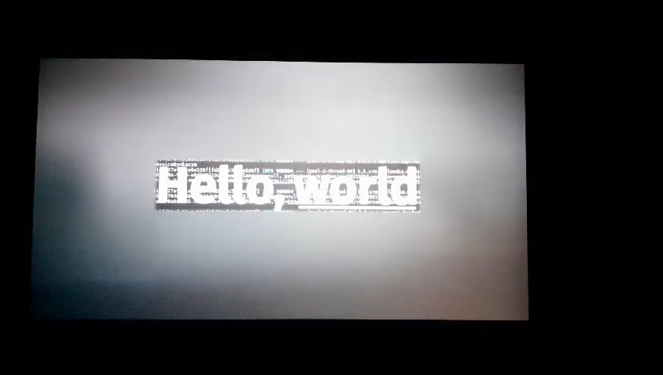

Slide 13
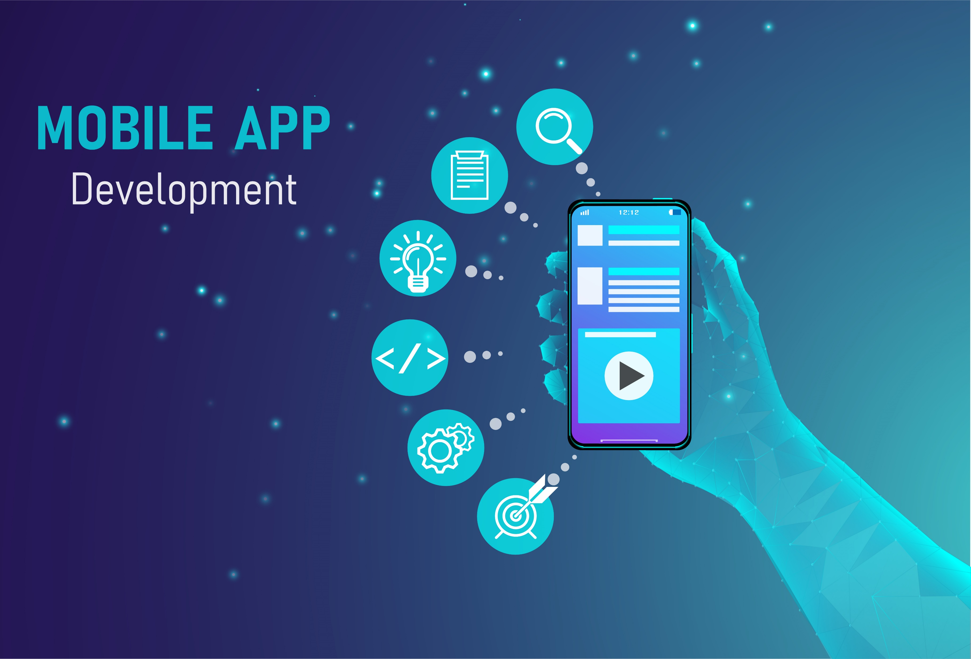

Slide 14

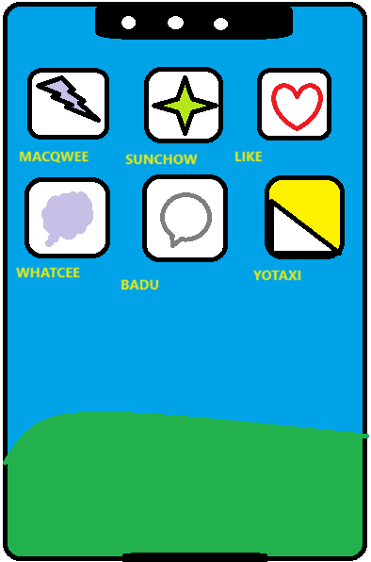
App development, short for application development, refers to the process of creating software applications that run on various platforms, including mobile devices, desktop computers, web browsers, and more.

Slide 15
